Slide 1
What factors affect students’ learning through Carbon TIME?
Qinyun Lin, Kenneth A. Frank, & Charles W. Anderson
NARST Annual Meeting
April 2, 2019 – Baltimore, MD

Slide 2
Outline
How well does CTIME work for students in general?
How do various factors affect students’ learning through CTIME?
What can we say about teacher effectiveness?
Notes:
These are the three research questions that I will discuss in following presentations.

Slide 3
1. How well does CTIME work for students in general?

Slide 4
How to figure out the effects of CTIME among all the factors?
We know there are many factors that may affect students’ learning outcomes in general.
Question is: how can we figure out the unique contributions made by CTIME and maybe compare its importance with other factors?
Students’ learning outcomes (e.g.
Posttest)
Curricula such as CTIME
Teacher effects
School resources
Students’ prior knowledge
Notes:
We know that there are many factors that may affect students’ learning outcomes, such as curricula like CTIME, the role of teachers, school resources and students’ prior knowledge. But we want to figure out the unique contributions made by CTIME and compare its importance with other factors.

Slide 5
Two-ways to think about how well CTIME works
Approach 1 (Pre vs. Post): Compare pre and post from same students taught by same teachers with CTIME
Approach 2 (CTIME vs. non-CTIME): Compare posttest from two groups of students taught by same teachers with CTIME and other curricula
Pretest before CTIME
Compare CTIME with other curricula
Mary
Jack
Posttest after CTIME
Posttest after other curricula
CTIME effect
Mary
Joe
Ann
Jack
Notes:
In CTIME, we have two approaches to answer this question.
The first is to compare pre and post from the same students taught by same teachers with CTIME. That is, we measure students’ proficiency before they learned CTIME and then measure their proficiency again after they learned CTIME. By comparing their pretests and posttests, we can learn about their progress by learning CTIME.
Alternatively, in the second approach, we compare posttests from two groups pf students taught by same teachers but with different curricula. One group of students studied CTIME while the other group studied other curricula. By comparing how different these two groups of students performed in the posttests, we can study how CTIME helped students learn compared to other curricula.

Slide 6
Approach 1 (Pre vs. Post):
can check the gain score for each student since we can match pretest and posttest
Students’ prior knowledge can be controlled by pretest
We report results for 2016-17 4630 students from 78 teachers (with 15 students at least)
Approach 2 (CTIME vs. non-CTIME):
can only compare at the mean level because we can NOT match pretest and posttest
Students’ prior knowledge controlled by assuming the two groups of students have similar prior knowledge on average
We report results for 2016-17 2209 students for other curriculum and 2381 students for CTIME from 39 teachers
All student learning levels are results generated by IRT analyses talked in last Webinar.
Carbon Dimension/macroscopic scale explanations
Comprehensive Dimension: carbon + inquiry + large scale

Slide 7
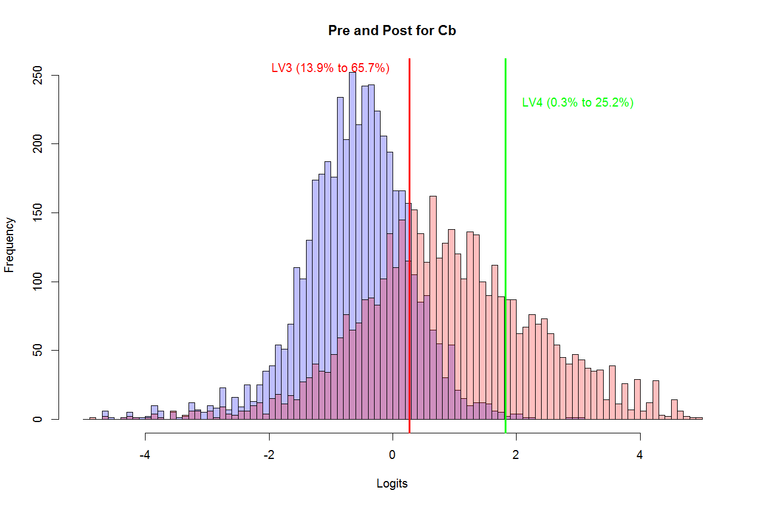
Approach 1 (Pre vs. Post): Distribution of pre and post in the Carbon Dimension
Average increased from -0.6307 to 0.7788
Notes:
Let’s see some results from these two approaches.
This figure shows the findings from the first approach, where we compare the pretest and posttest for the students who learned CTIME.
The blue part shows the distribution of pretest and the pink part shows the distribution of posttests. If we compare these two parts, we can see that students’ proficiency level increased from pretest to posttest.
The unit of analysis on the X axis is logits, an IRT-based measure of overall student proficiency, with 0 as the grand mean for all students.
The average increased from -0.6 to 0.7, which is a gain of about 1 level on our learning progression framework. Also more students achieved LV3 and LV4 (the two highest levels in our learning progression framework) from pretest to posttest.
LV3: from 14% to 66%
LV4: from 0.3% to 25%

Slide 8
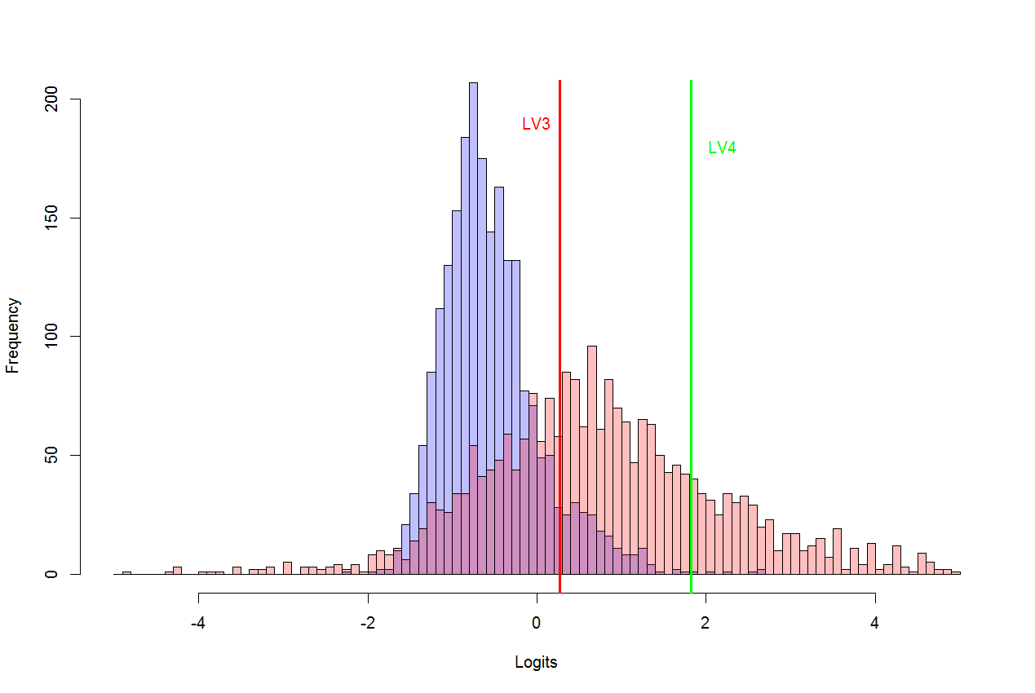
Approach 2 (CTIME vs. non-CTIME): Posttests for CTIME & non-CTIME students in the Carbon Dimension
The two averages are -0.547 and 0.649
Notes:
Here is the findings from the second approach, where we compare students who studied CTIME with students who studied other curricula. The blue part shows posttest distribution for students studied other curricula. The pink part shows the distribution for students who studied CTIME. We can tell that students who studied CTIME performed much better in posttest than students who studied other curricula. The average difference is around 1.2 logits. We can also see that more students can achieve LV3 and LV4 in the CTIME group.
The average difference is 1.197 logits
Non-carbon post slightly better than carbon time pre

Slide 9
Notes:
Now we want to compare CTIME with other factors that can affect students’ learning. We found that teachers and school organizational resources are two other factors that are significant in explaining students’ learning outcomes. In this analysis we used unit posttest scores as the outcome measure. Here in this picture, we decomposed the variance in students’ achievements into three important factors:
CTIME as a curriculum (variance associated with differences between pretests and posttests),
differences among teachers (variance associated with identities of individual teachers), and
school resources measured by FRL%.
For example, the orange bar here, on the very left, shows that CTIME makes more than 25% contributions to students’ learning in S&S unit. Similarly, this orange bar in the middle shows that teachers make a contribution of about 11% in students’ learning of S&S unit. And school resources only accounts for less than 5% of the total variance. In fact, among all of the three units, we can tell that CTIME has shown to be much more important than teachers and school resources.
Another interesting finding here is that we see from SS to animal to plant, the important of CTIME has increased. Because the data here only includes 51 teachers who have taught all of these three units in an order (the order is SS first, then animal then plant), this finding is basically saying CTIME has an accumulative effects on students’ learning since it is becoming more and more important from 1st unit to 3rd unit.
(This result is from 51 teachers who taught SS, Animal and Plant in order. CTIME has an accumulative effect.)
(Explain for the variance we are explaining here.)

Slide 10
2. How do various factors affect students’ learning through CTIME?

Slide 11
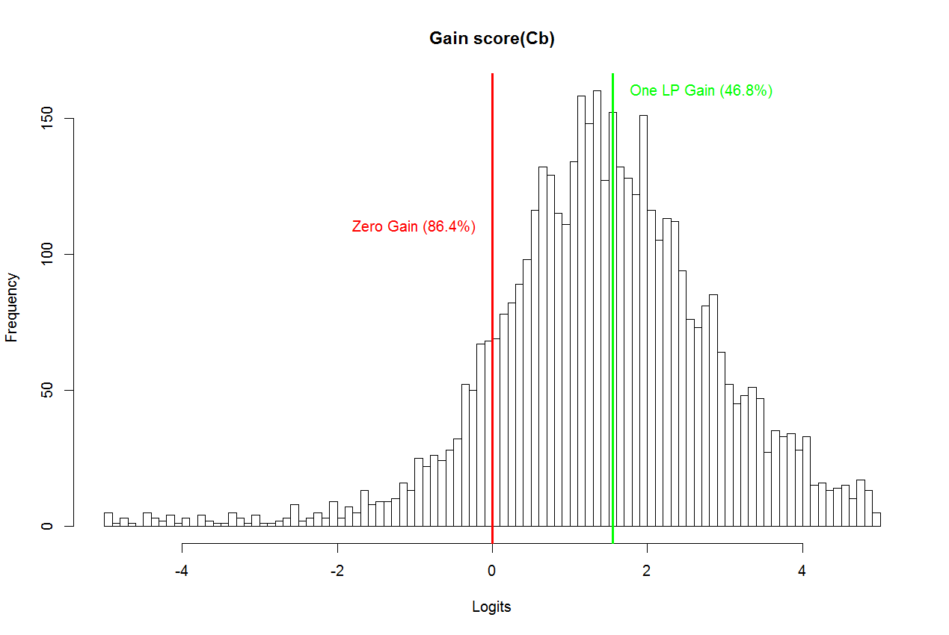
Approach 1 (Pre vs. Post): Distribution of gain scores (post – pre) in the Full tests
Notes:
This picture shows the distribution of gain scores for all the students using overall posttests as the outcome measure. We see that students vary a lot in terms of how much they improved their test performance. We want to know what factors help explain this variation: why students learn differently from CTIME?
In total we have 4630 students from 78 teachers.
4001 students get positive gain scores. 2166 students get at least 1 LP gain (1.551). Average gain is 1.406.
This is Carbon Dimension

Slide 12
Important factors affecting students’ learning from CTIME
Students’ learning from CTIME
(Gain score)
Teachers
Within-class
Students’ prior knowledge (Pretest)
Between-class
School resources (FRL)
Class A: average is 88
Class B: average is 90
89
85
84
96
91
89
Notes:
In general, after a series of analyses, we found that three factors are important to explain how much students learn from CTIME. These three factors include:
Students’ prior knowledge
The role of different teachers
School organizational resources (measured by percentage of FRL)
[Omit this part if short on time.]
We further decompose the first factor-students’ prior knowledge into two parts: within-class and between-class.
Explain what is within-class: Assume we have two classes A and B presented here. For this boy with score 89 in class A, his within-class component is positive 1 because he is one point higher than his class average 88. In class B, there is also a boy has score 89. However, his within-class component is negative 1 because he is 1 point lower than his class average, which is 90. That is, the within-class measures how far each student deviates from his/.her class average.
The between-class is basically the average score for students. For all students in class A, their between-class is 88. For all the students in class B, their between-class is 90.

Slide 13
Important factors that affect students’ learning from CTIME
Lower pretest scores are associated with higher gain scores
Students’ learning from CTIME (Gain score)
Students’ prior knowledge (Pretest)
Within-class
-
Teachers
Between-class
Between-class
+
Higher FRL is associated with lower gain scores
School resources (-FRL)
Notes:
Here shows how these important factors affect students’ learning from CTIME.
The within-class component in students’ prior knowledge has a negative effect on students’ learning. That is, the lower-end students in one class can learn more from CTIME.
The school resources have a positive effect on students’ learning. That is, when a school is in lack of school resources (reflected as a higher FRL%), the students will benefit less from CTIME.

Slide 14
The other factors that we have excluded because they do not have significant unique contributions
Gain Score (Post – Pre)
Students’ prior knowledge (Pretest)
Teachers
Grade band (whether high school or middle school)
Percentage of minority students
School resources (FRL)
Notes:
The other predictors we have tried include grade band and percentage of minority students. Neither of these shows a robust statistically significant effects.

Slide 15
How do various factors affect students’ learning through CTIME?
Carbon TIME reduced the achievement gap between higher pretest and lower pretest students within classrooms.
Carbon TIME was less successful in higher poverty schools with fewer organizational resources.
Other variables were not significantly associated with student learning gains.

Slide 16
3. What can we say about teacher effectiveness?

Slide 17
Classrooms vary in terms of gain scores
Notes:
This figure uses unit posttests as the outcome measure. It shows average gain scores for teachers who have taught all of the three units: S&S, plant and animal. We can tell that classrooms vary a lot in terms of the average learning gains. (N=52)

Slide 18
What can we say about teacher effectiveness?
Notes:
This figure shows our best estimates of overall effectiveness for six focus teachers. The expected gain is calculated using FRL and students’ pretests as controls. If a teacher has a positive value here, it means that his/her students are doing better than the expected gain.
We compared results using full posttests and unit test posttests as the outcome. (We generally believe that the unit posttests provide more valid measures of teacher effectiveness.)
We observe that there are some consistent patterns here. That is, some teachers are better than the others in terms of effectiveness or how much they help their students learn from CTIME using either outcome measure.
[Stop here if short on time.]
The only exception is teacher Mr. Gilbert. But we also got an explanation for this. That is, he is the only teacher who teaches all of the 6 units. The full test includes content from all 6 units. Thus for students in other teachers’ classrooms, they need to deal with these untaught content in full tests. This can help explain why Mr. Gilbert’s students perform relatively better in full test compared to unit tests. (also shows a near transfer and far transfer) This is also why we think unit tests are better measures when we want to evaluate teacher effectiveness. In fact, we also have evidence that unit tests are being treated with more effect.

Slide 19
Science teaching practices affecting students’ learning
Positive:
Record students' ideas to use again in later lessons.
Negative:
Teach key vocabulary words and definitions at the beginning of a unit.
Explain an idea to students before having them consider evidence that relates to the idea.
Notes:
To study why teachers differ in terms of effectiveness, we try to use some survey data to explain the differences in how teachers teaches. In the survey, the teachers were asked how often they did each practice. Here we listed three teaching practices that have shown consistent relationships with students’ gain scores.
The “positive” practice “Record…” shows a positive relationship with students’ learning. That is, the more often teacher reports doing this practice, the higher their students’ learning gains.
On the contrary, we found there are two negative practices that can reduce students’ learning growth. These two practices are: “Teach….” & “Explain…”.
In following presentations based on classroom video and teacher interview data, we will learn more about how teachers differ and how their differences may relate to how much their students learn.

Slide 20
Thanks to our funders
This research is supported by a grant from the National Science Foundation: Sustaining Responsive and Rigorous Teaching Based on Carbon TIME (NSF 1440988 ). Any opinions, findings, and conclusions or recommendations expressed in this material are those of the author(s) and do not necessarily reflect the views of the National Science Foundation.
Notes:
Thanks to the National Science Foundation for funding this research.

